Slide 5
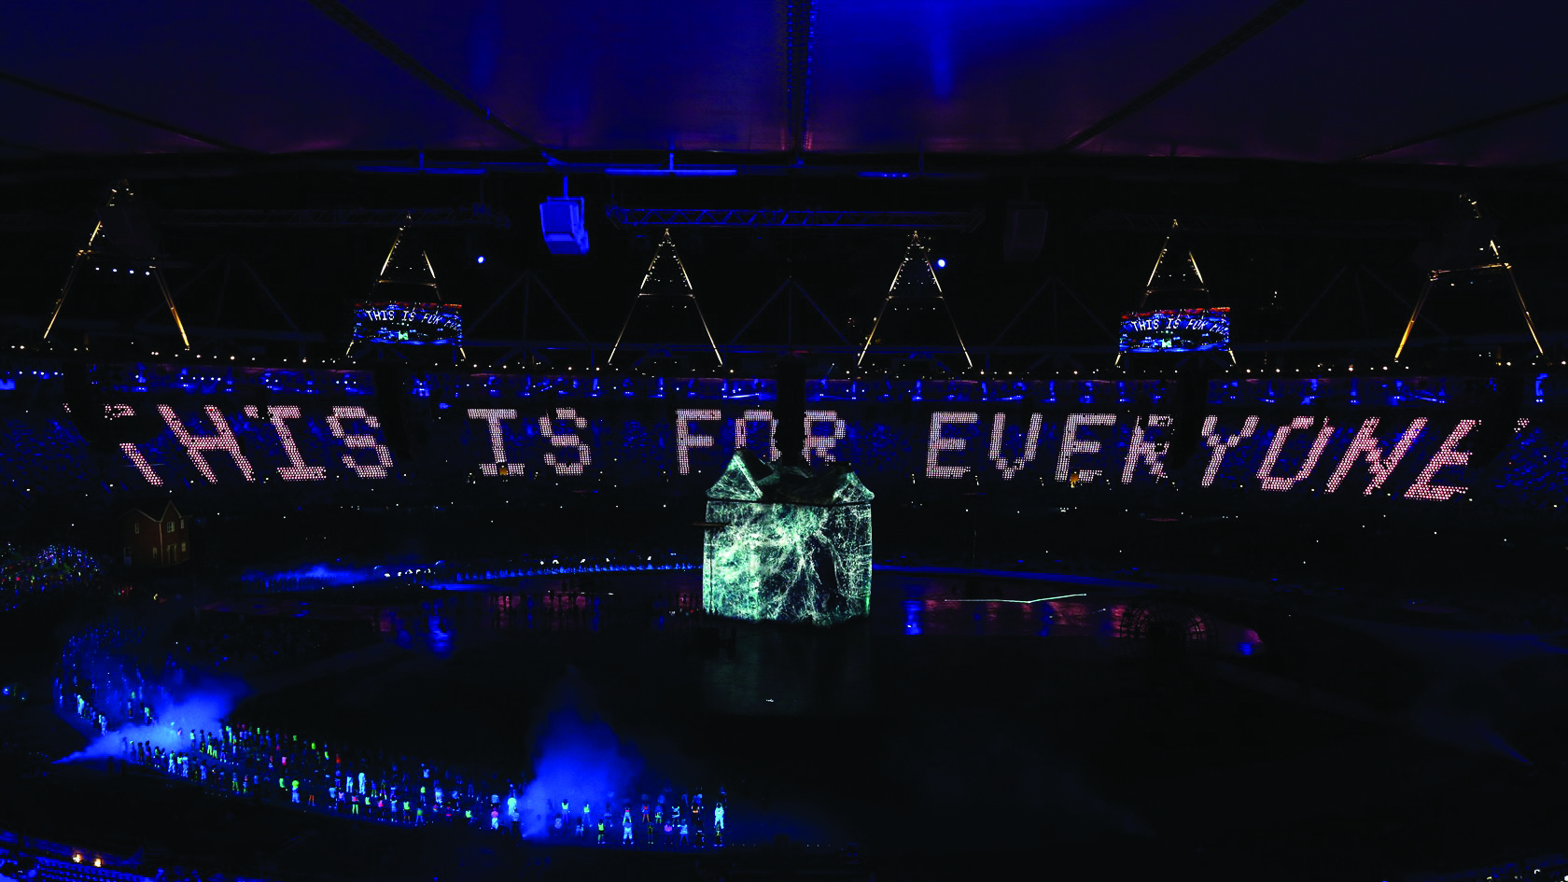

Slide 7
Your good friend enjoys uploading videos to the internet sharing top tips for Minecraft. Yesterday you went to check out his latest post and spotted some mean comments underneath.
One user in particular has left comments like:
‘Ha ha your voice is so weird, why are you talking like that?’ and others have also commented on the words he has used. You know this will have upset your friend as he is trying to help others with Minecraft.

Slide 8
Do nothing
Tell an adult
Write a comment back
Something else

Slide 9
You’re researching online for a homework project about your favourite country. You find a website where people can post their own fun facts and share what they think. You see that one person has posted lots of messages saying very horrible things about people from that country. They’re trying to get other people to hate them too.

Slide 10
Tell an adult
Report the comments to the website
Close the website and never use it again
Something else

Slide 11
You’re chatting with friends online and one of the friends shares a joke that makes fun of someone’s religion. Another one of your friends writes back with this message about it:
That’s not funny, it really upsets me.

Slide 12
Help your friends to talk it out
Tell an adult
Block the friend who posted the joke
Something else

Slide 13
Tell someone
Report it
Block the comment or user
Look for another site to use
Don’t join in or fight back
Help your friends to talk to each other
Ask someone what they meant
Remind your friends that not everyone finds the same things funny
Before you say what’s on your mind ask yourself is it kind?

Slide 14
They can help to explain what you have seen
They can help you to block or report comments and users
If what you saw upset you, they can help make you feel better
They can help you to find another website to use next time

Slide 17
Likes and kind posts
Be an upstander
Report and block hurtful accounts

Slide 18
SAFE | Keep your personal information safe
MEET | Friends made online are strangers; meeting them can be dangerous
ACCEPTING | Accepting files can be dangerous. If unsure, ask an adult!
RELIABLE | Not everyone or everything online is reliable or trustworthy
TELL | Always tell an adult if something online upsets or worries you

Slide 19
Safer Internet Day 2016 Education Packs by UK Safer Internet Centre is licensed under a Creative Commons Attribution-NonCommercial-ShareAlike 4.0 International License.

